Slide 1
5th Annual SEFH Seminar
presented by
sponsored by

Slide 2
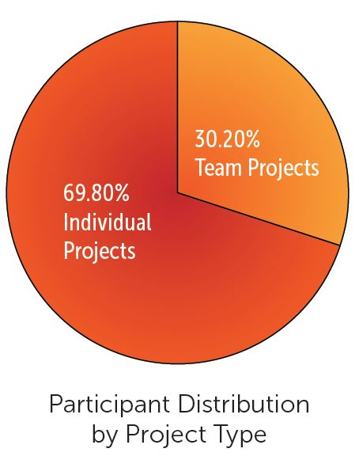
By the Numbers
920 participants from grades 7–12
22 Participating School Districts
495 Judges
17 Project Categories

Slide 3
How did we do at ISEF?
Student Name | Grand Place Award/Category | Place
Smiti Gandhi | Physical sciences | 4th
Andrew Liu | Physical sciences | 4th
Michael Gerhard | Environmental Engineering | 3rd
Kabir Jolly | Environmental Engineering | 3rd
Andrew Kim | Animal sciences | 3rd
Syamantak Payra | Robotics and intelligent Machines | 1st

Slide 4
How did we do at ISEF?
Student Name | Name of the Award/Category | Place | Monetary Prize / Prize
Alyssa Knowles | Certificate of Honorable mention/American Psychological Association | Honarable mention | Certificate
Adham Mohab Kassem | Tuition Scholarship Award/ University of Arizona
Syamantak Payra | Award to participate in summer school “Web Valley” in Trento, Italy / Fondazione Bruno Kessler |  | Trip to Italy for research
Syamantak Payra | International Council on Systems Engineering - INCOSE/ Certificate of Honorable mention | Honorable mention | Certificate
Syamantak Payra | King Abdul-Aziz & his Companions Foundation for Giftedness and Creativity/Research in innovative technology |  | $1,000
Syamantak Payra | Oracle Academy/Outstanding project in the system category |  | $5,000
Andrew Dong-Hyun Kim | Patent and Trademark Office Society | 1st | An American flag, and a framed copy of the first patent granted in the United States of America
Smiti Gandhi | Physical sciences/Sigma Xi, The Scientific Research Honor Society | 2nd | $1,000
Andrew Liu | Physical sciences/Sigma Xi, The Scientific Research Honor Society | 2nd | $1,000
Andrew Kim | Air Force Research Laboratory on behalf of the United States Air Force/Animal sciences | 1st | $750

Slide 5
What about Broadcom MASTERS?
2018 Top 300
Victor Markhasin- Grade: 8th (The Emery/Weiner School)
Austin Nelson- Grade: 7th (Seabrook Intermediate School)
Pratishtha Sharma- Grade: 8th (Seabrook Intermediate School)
Anisha Parsan- Grade: 7th (Fort Settlement Middle School)

Slide 6
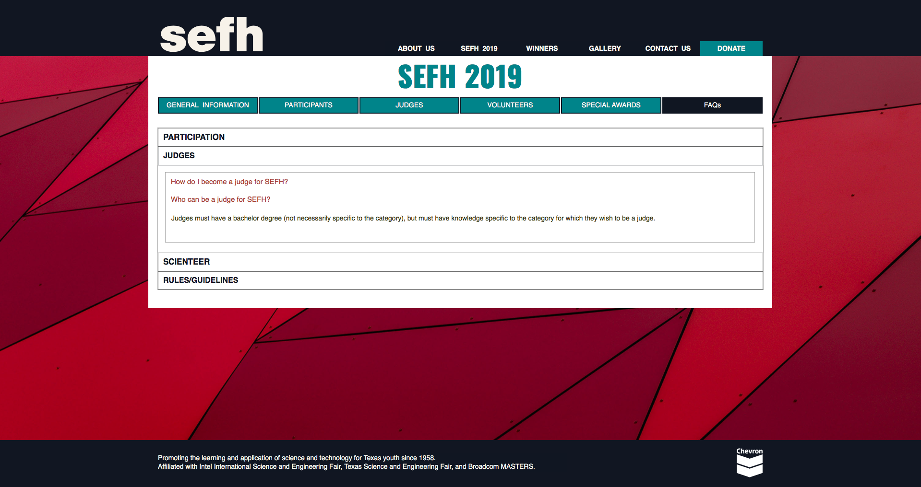
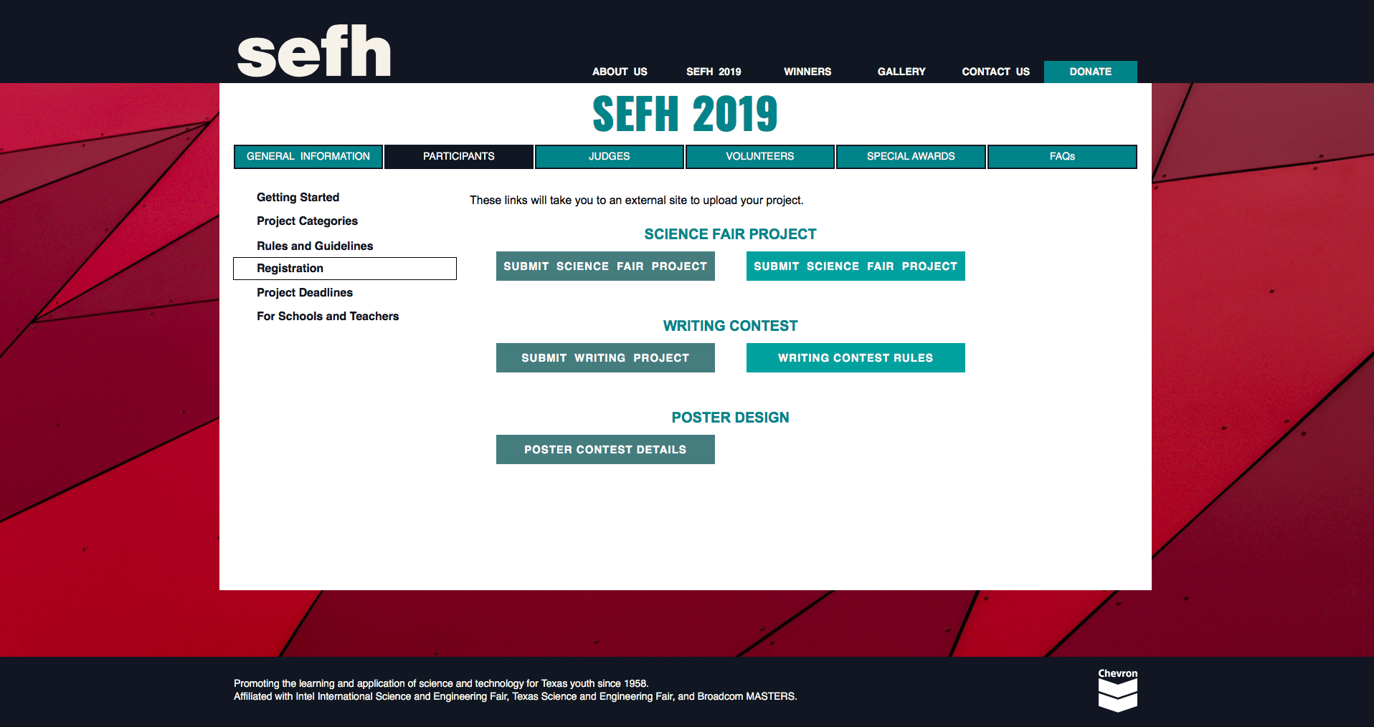
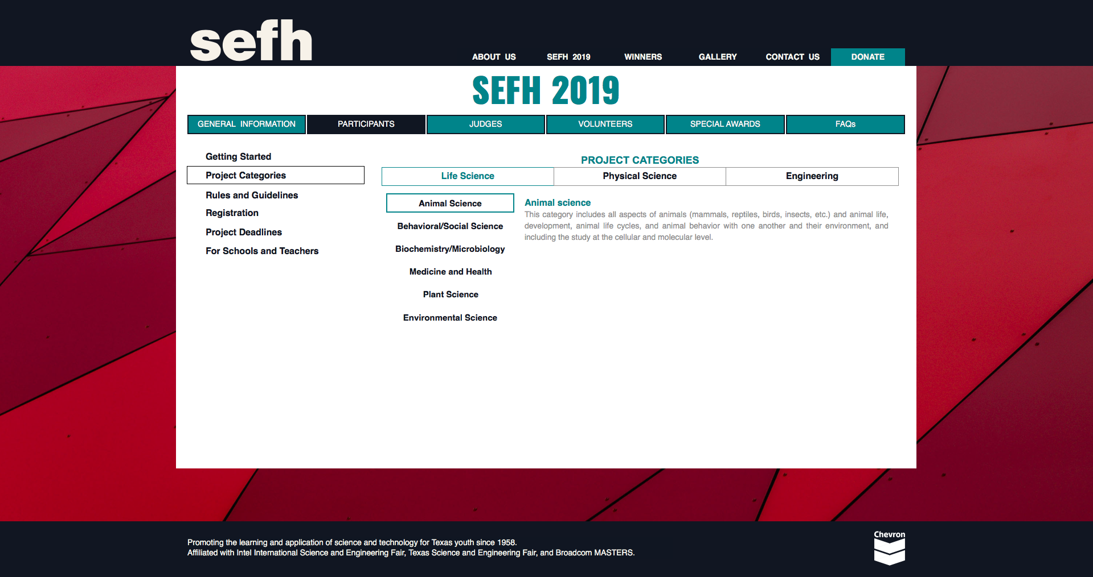
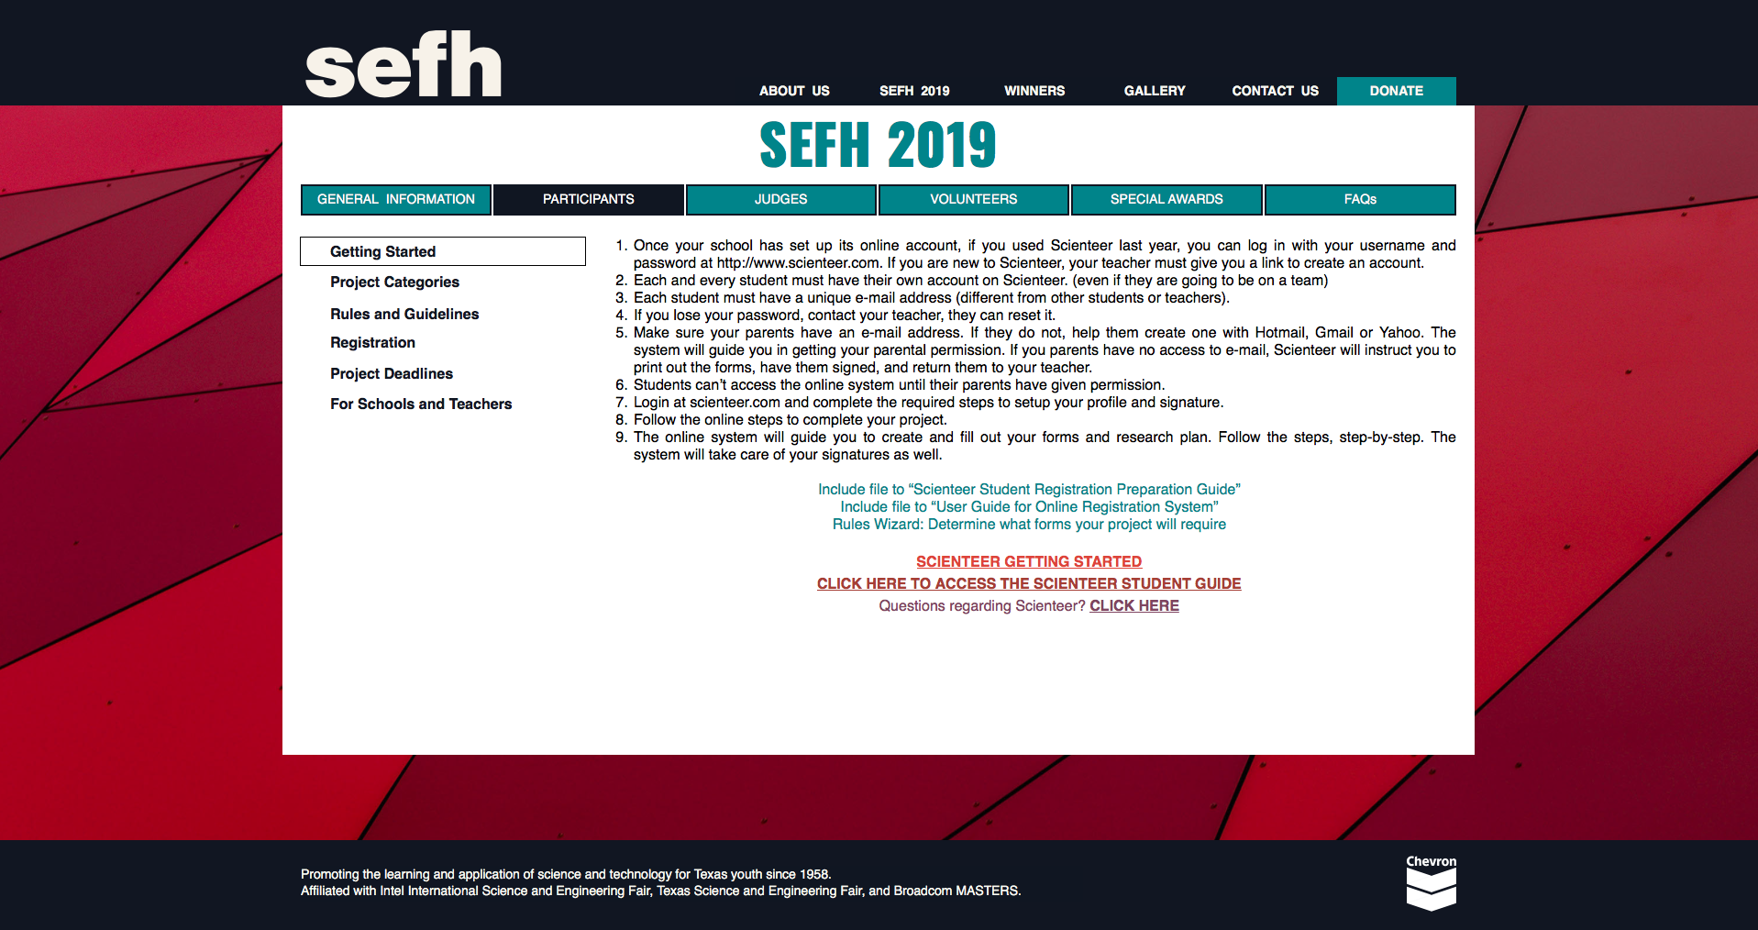
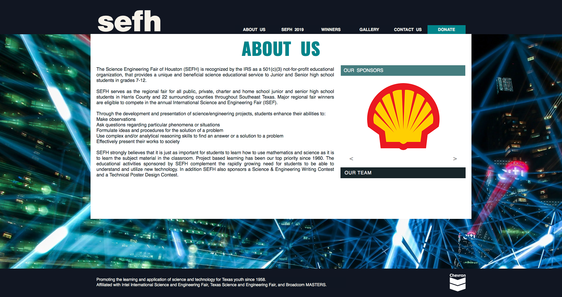
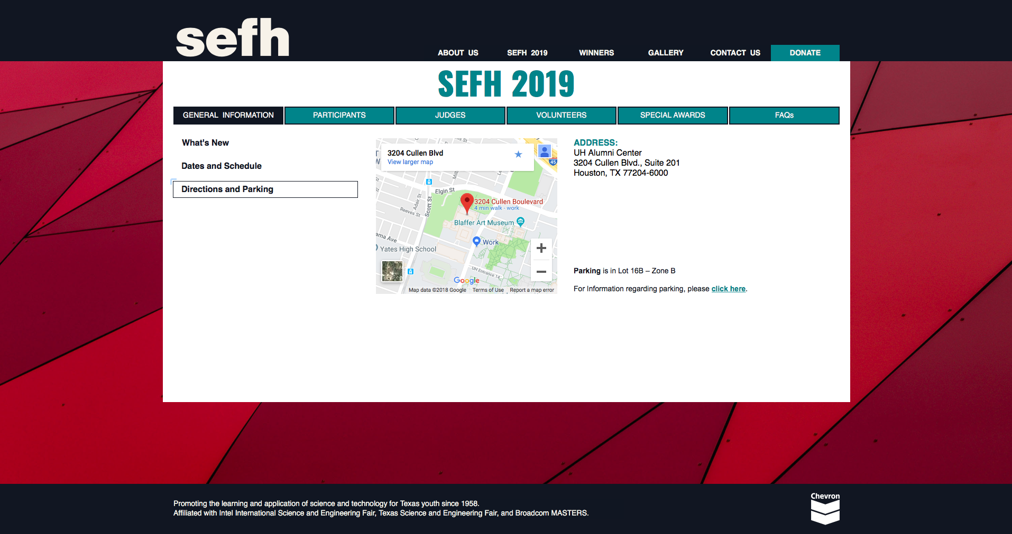
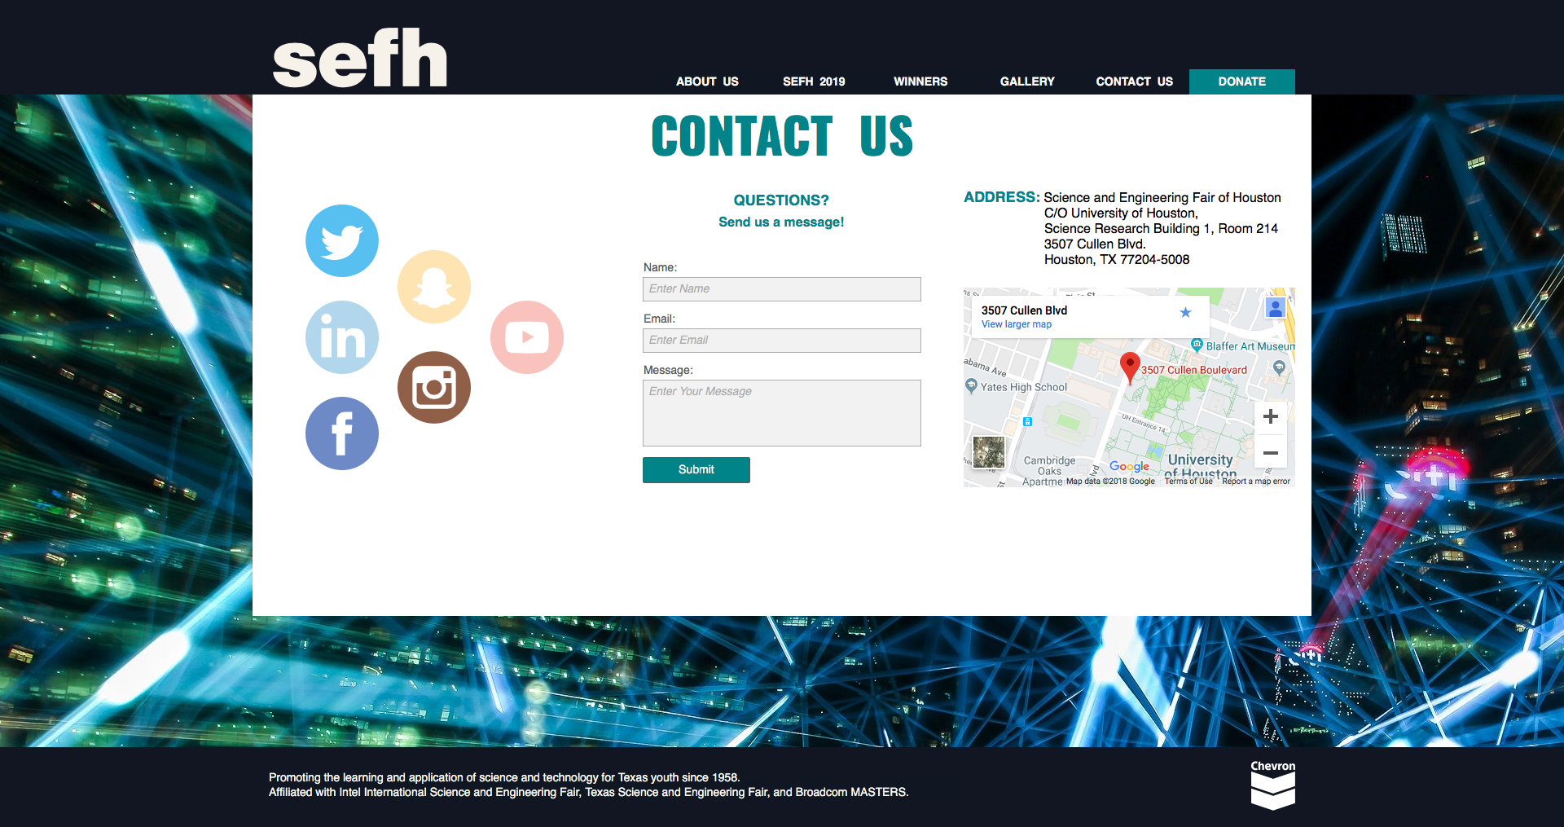
Website Updates

Slide 7
Survey Feedback Please!

Slide 8
Questions/Comments?
presented by
sponsored by

