Slide 1
What a Great Idea!
Strategies for Generating Science Fair Research Questions
Alaina Garza- Clear Brook High School
Clear Creek ISD

Slide 2
Step 1: What are you interested in?
What field of STEM do you enjoy reading about, listening about, or watching about?
You are going to be spending a lot of time studying this, so make sure you really enjoy it and are passionate about it.

Slide 3
Step 2: start observing
The more you read about, listen about, watch about your topic of interest… the quicker you will discover your question.

Slide 4
FIND OUT WHAT RESEARCH IS ALREADY GOING ON IN YOUR AREA OF INTEREST!
Listen to Podcasts- Radiolab, Science Friday, BBC Discovery, Hidden Brain, Science PBS News Hour, etc.
Read journal articles and abstracts- Google Scholar, JSTOR, Google Dataset Search.
Watch Youtube channels, check out Twitter feeds, look at science websites.

Slide 5
Step 3: look for a gap in the research or a problem That needs a solution
Your project should be meaningful and unique.
Who or what are you helping?
Why is this a necessary project?
What research is already being done in the field and what are their solutions/conclusions?
What would this project contribute to existing research?
Why is this important to you?

Slide 6
Step 4: Draft Your research
This probably will not be your final question… it takes time and background research to develop that.
Start reading journal articles that you can find that pertains to your drafted question.
This will help you to refine and narrow the question.
Keep in mind:
Time frame
Materials access
Cost
Location

Slide 7
Talk to people!
Talk to family and friends about your question. They will be able to ask you clarifying questions. You will begin to recognize areas of your question that need to be refined.
E-mail experts in the field. If you read a particularly interesting journal article, you can always look up and e-mail the author with questions about the data, methods, conclusion, etc.
The more people that you discuss your project with, the more developed it will become.

Slide 8
www.cbsef.weebly.com

Slide 9
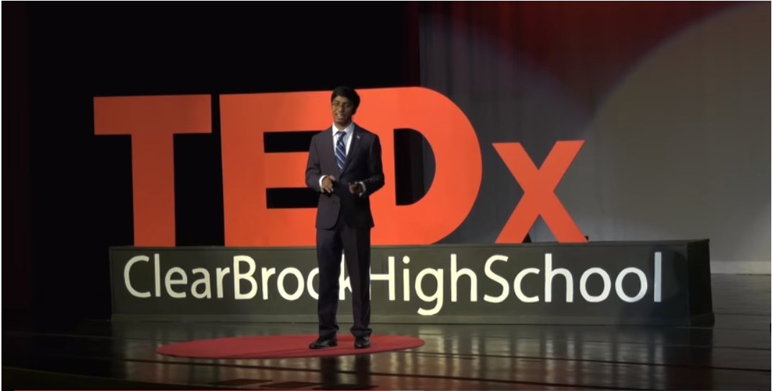
Inspiration from a science fair superstar

